Slide 1
Our Story
Who are we?
Background
The problem and solution
The service and outcomes
SchoolVue Demonstration
Summary
schoolvue@uk-skills.com
uk-skills.co/schoolvue

Slide 2
Our Story
UK Skills has a long experience in developing and delivering learning, assessment and qualifications. We have a clear focus on new technology leading to the new approaches needed to meet the demands from developing countries for skills development.
We are a not for profit provider with rigorous and robust quality assurance processes that lead to learning and qualifications that work for the learner, the provider, the employer and the stakeholders.
UK Skills and SchoolVue formed a working partnership in 2019. SchoolVue is an easy to use online analytics tool which has been developed in partnership with UK schools. Many of the features and ideas have come from the senior leaders and classroom teachers who use it.
schoolvue@uk-skills.com
uk-skills.co/schoolvue

Slide 3
Who are we?
Jon Munt
(SchoolVue CEO and founder)
Experienced School Senior leader and education consultant
Business owner providing services to the education sector
Expert in curriculum, data and assessment
Dr Tejwant Chhatwal
(UK SKILLS Executive Team)
Qualified developmental psychologist and a scholar from Stanford University, specialising in Multiple Intelligence Practice
Conducted over 2700 workshops in more than 800 institutions
Over 70 years combined experience in education
Jeff Ross
(UK SKILLS Executive Team)
Independent Prince II project manager and consultant with expertise in e-Assessment, e-learning and the use of IT and internet technologies in education, learning and training, including instructional design and qualification development
John Kerr
(UK SKILLS Executive Team)
Former CEO of the Edexcel Foundation
Trained as a lawyer and held senior positions with the London Stock Exchange and FSA before his career in education

Slide 4
Background – Data analytics in the UK
The use of data analytics in the UK education sector has grown rapidly. For a long time, Schools have been collecting large quantities of information on their students.
The analysis of this information now drives:
Student progress
School improvement
Staff training
Strategy at local government / Academy level
School Evaluation

Slide 5
Background – Data analytics in the UK
School Evaluation UK
“The intelligent use of data affects the work of all professionals involved in education. There can be no going back to the days when decisions were made on hunches and anecdotal information. But we have to present and explain data in ways which inspire trust and confidence, and lead to appropriate choices and judgements being made. Using data, improving schools is intended to help everyone involved in school improvement achieve this goal.”
Christine Gilbert, Her Majesty's Chief Inspector
“- Indeed, the growth of data has undoubtedly changed the nature of inspection work. In England, the commitment to data use in governing education has been particularly strong (Ozga, 2009).
The development of data connects directly to successive governments’ prioritisation of attainment (measured by test results) and to a determined effort to shift school cultures so that data monitoring and active data use became the driving force of school activity and hence improved performance“
Digital Education Governance and the inspection process
Department of Education, The University of Oxford, UK
The Benefits
Students and Parents
Parents and carers to help them make important decisions with their children – appropriate and timely data can help parents, carers and children to understand what is going on in a school and, if necessary, to ask probing questions about its performance
Schools
School performance data matter because they provide the basis for schools’ accountability to their users and the local community, for their own monitoring and self evaluation and for their planning for improvement. Such data also inform judgements about whether a school is providing value for money.
Local Government
Local authorities to monitor the performance of the schools under their control, to plan for improvement and to allocate resources
Ofsted - Office for Standards in Education
Using data, improving schools

Slide 6
The Service - Outline
The Problems – Speaking to Indian Principles and CEO’s
Schools in India collect a large amount of student information but do not have the expertise or technological solution to effectively analyse and use the data.
ERP solutions are growing in popularity and choice. They are a useful tool for data capture and storage but do not provide the necessary analytics capabilities to drive school improvement.
Networks of Schools do not have a centralised approach to processing and analysing school data in order to drive strategic decisions. ERP solutions work in isolation.
Employing data experts in a school is not a cost-effective solution to data analytics.

Slide 7
The Service - Outline
The Solution
Provide a complete data analytics service to individual Schools and Networks of Schools in India.
This will include:
Online analytics solution - SchoolVue
Centralised data manager provision for Schools (UK Skills Delhi based Data Team)
Key benefits:
SchoolVue is unique and will compliment the broad range of ERP solutions by providing easy to use dashboards to drive school improvement
The Data Team will provide exam board expertise in terms of tracking and monitoring an unify the approach to data collection for networks of schools

Slide 8
The Service - What is SchoolVue?
SchoolVue is a powerful online analytics tool that genuinely helps a school to provide excellent provision and support for its students. Interpreting and sharing information is key to driving performance.
SchoolVue is designed for:
School Leaders
Classroom teachers
Parents and Students
Networks of Schools

Slide 9
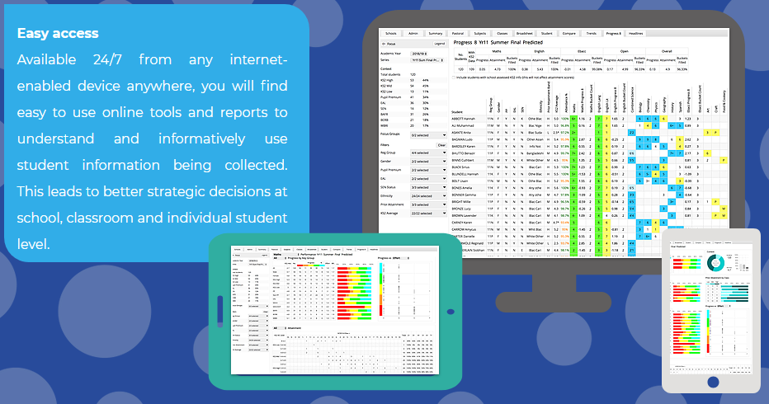
The Service - What is SchoolVue?
The online dashboards focus on
four key areas:
Multiple schools performance
Individual school performance
Subject performance
Student performance

Slide 10
The Service – Delhi based Data Centre
The Data Team will be made up of experienced educationalists and data analysts. Their purpose is to advise and assist schools in collating student information ready for processing. They will fully manage the SchoolVue analytics tool on behalf of the schools and provide data collection templates.
Data Centre

Slide 11
The Service - Model
Network of Schools
Schools
Parents and students
Schools collect CBSE / State Board / ICSE Student Assessment Data throughout the year
Schools send assessment data to UK Skills data centre
Data Centre
The Data Centre upload the data and manage SchoolVue

Slide 12
The Service - Outcomes
Network of Schools
Schools
Students and Parents
Provide an overview of a network of schools as one organisation.
The analytics are used to drive school improvement strategy.
Networks of Schools can monitor:
Individual school performance compared to the group
Subject performance within the group
Performance of key student groups
Use the interactive functions in SchoolVue to explore:
Whole School performance
Subject attainment and progress overviews
Student performance
Schools use the analytics to drive student progress and identify school development needs.
Schools engage and communicate with parents electronically to provide up to date performance information on their child.
View overall and individual subject performance for a student
Monitor attendance
Compare student performance against year group averages

Slide 13
SchoolVue Demonstration
SchoolVue can be configured for any Exam board
Our demonstration school

Slide 14
Summary
We want to work with your schools to ensure data analytics is central to school improvement
The data team will take the headache away from managing tracking and monitoring and provide valuable expertise
SchoolVue will effectively identify under performance as well as good practice to drive staff training and interventions for students

